Slide 1

A PRESENTATION BY TEAM PREDILYTICS

Slide 2
Team PREDILYTICS
Prajesh PATEL
Arnold WAMULANGA
Kelechi NWACHUKWU

Slide 3
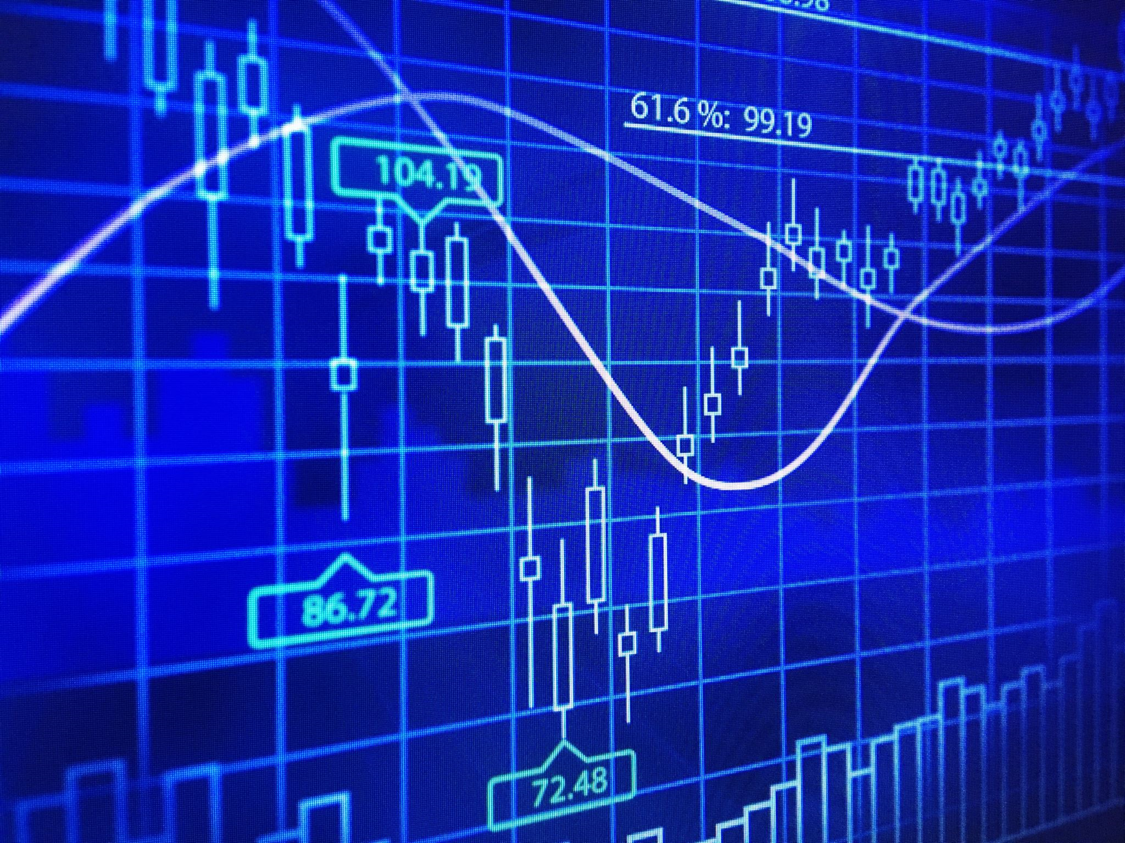
Scope of project.

Slide 4
Scope of project.
The goal of the project is to do;
Technical analysis
Visualization
and prediction using data sourced from Google Finance.

Slide 5

Tools used in project.

Slide 6
Tools used in preparation of the project.
For this project we’ll use tools including;
NumPy
Pandas
Libraries (particularly matplotlib, seaborn)
to create representations in form of graphs to highlight the analysis of data from the stock market for companies; Google (GOOG), Apple (AAPL), Facebook (FB), Microsoft (MSFT) and Tesla (TSLA).
The data source this report will rely on is Google Finance.

Slide 7
Breakdown of tasks for this project:
Analyze data based on the research questions.
Create graphs based on the research questions.
Ticker Selection for the companies selected:
Google (GOOG)
Apple (AAPL)
Facebook (FB)
Microsoft (MSFT)
Tesla (TSLA

Slide 8

Research questions.

Slide 9
Research Questions
The following research questions are the most pertinent and relevant to this project:
What was the change in the price of the stock over time?
What was the moving average of the various stocks?
Show the correlation between different stocks' closing prices

Slide 10
What was the change in the price of the stock over time?
Stock prices change everyday by market forces. This question requires us to show the behavior of the stock for each company over time.
For purposes of this presentation, we sampled a timeline of 12months (between 2020-10 and 2021-09).
Change in the price of stock is affected by a number of factors including but not limited to; political events, changes in the organization, natural calamities, among others.
.

Slide 11
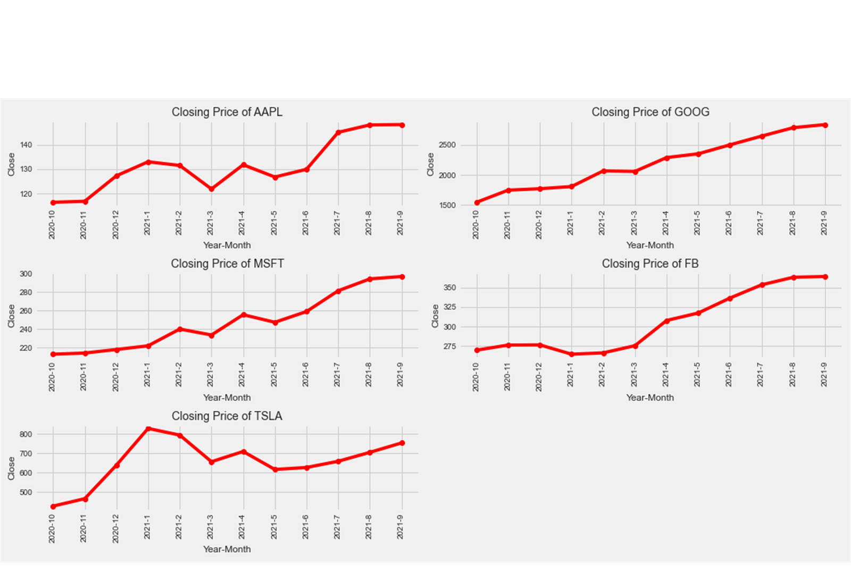
Change in price of stock (sample from 2020-10 to 2021-09)

Slide 12
All companies we sampled recorded positive numbers in change in the price of stock indicating an increase in the price of stock the respective companies.
APPL = 26%
GOOG = 79%
FB = 27%
TSLA = 73%
MSFT = 33%

Slide 13
What was the moving average of the various stocks?
A moving average is an indicator that shows the average value of a stock’s price over a specified period and is usually plotted along with the closing price. It is represented as a line chart.
If a moving average is rising, it means the stock is on an uptrend and the reverse is also true.
During this project, we quoted a moving average for 2months, 4months and 5months for the respective companies as shown in the next slide.

Slide 14
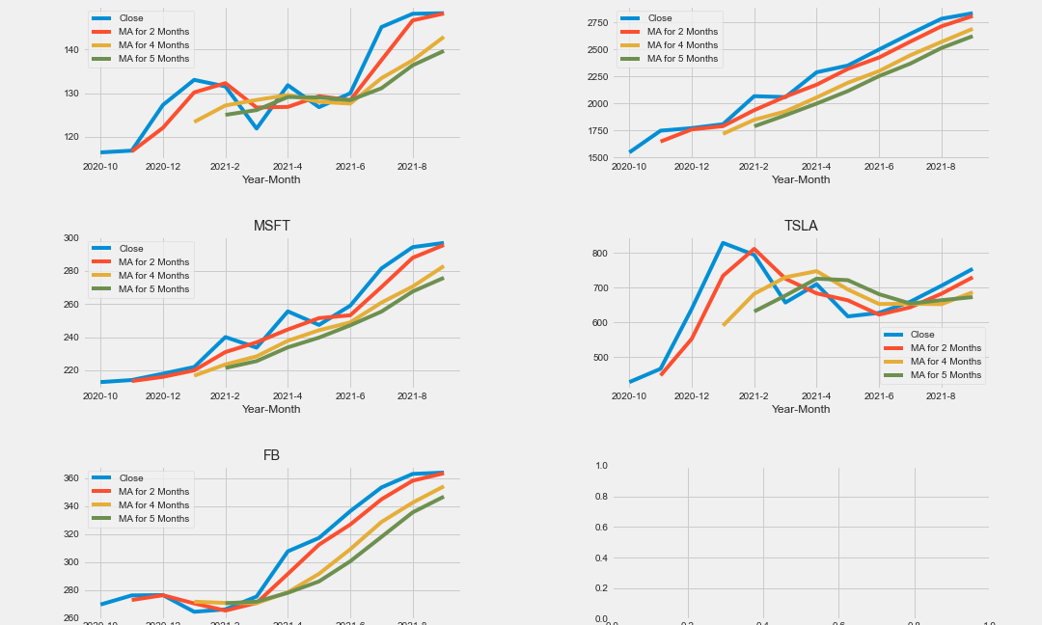
Moving averages for the respective stocks

Slide 15
You will notice that the 4 months and 5 months moving average is slower to adjust to the price changes because it uses more data points in its calculation. On the other hand, the 2 months moving average quickly responds to price changes because each value has a greater weighting in the calculation due to the less time period.
For example, the moving averages recorded for Google over the sampled period indicates that the company’s stock consistently maintained an uptrend generally performing better on the market compared to the other four companies we sampled in the same period.

Slide 16
Show the correlation between different stocks' closing prices
For purposes of this project, we have drawn a plot of two variables with univariate and bivariate graphs.
Furthermore, we used scenarios of different linear relationships when comparing with stock of the same company Vs different stocks.

Slide 17
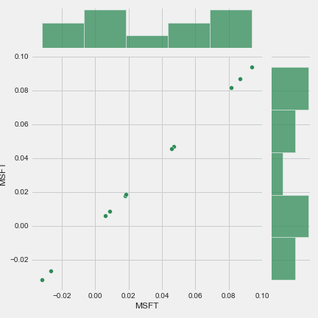
The linear graph below shows a comparison between MSFT stock, and because both stocks behave in the same manner we end up with a perfectly linear relationship.

Slide 18
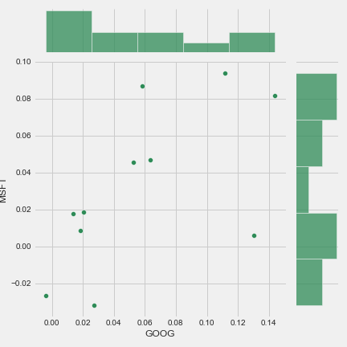
In the figure below we show a linear relationship between MSFT and GOOG stocks, and from how scattered the plots are, it implies that there is no relationship whatsoever between the two stocks.

Slide 19
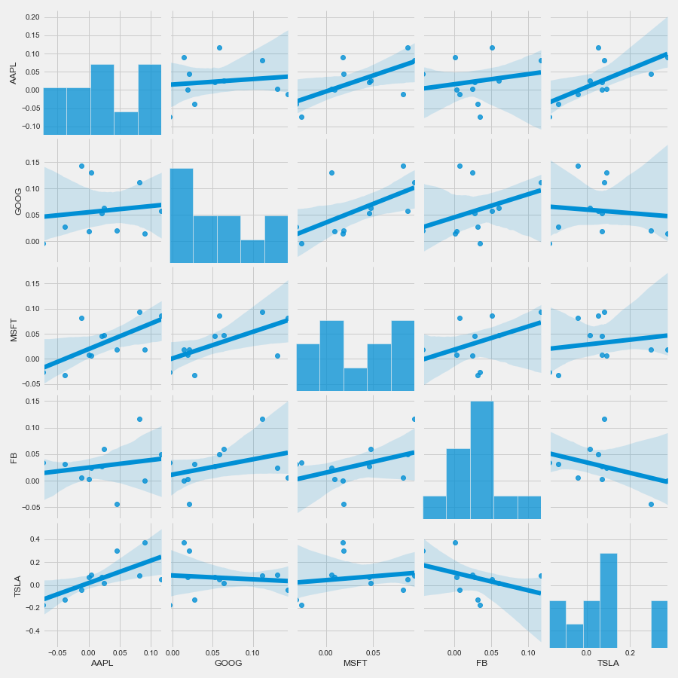
The figure below depicts how each of the stocks for the listed companies relate when plotted with a different company’s stock.

Slide 20
From the pair plots above we draw at least two conclusions.
TSLA and GOOG seem to show the same behavior and have an uptrend.
On the other hand, TSLA and FB have no relationship at all.

Slide 21
REFERENCES
Fares Sayah https://www.kaggle.com/faressayah/stock-market-analysis-prediction-using-lstm/notebook

